Slide 1

How the other half chooses to live: Housing Prices Drivers in U.S. High-Poverty Neighborhoods
Final Project by Team Umai for MACS30112 Winter 2024
Xuewei Li, Kuang Sheng, & Tian Lan
Notes:
Progress report: https://docs.google.com/document/d/1Tt_P23taxOHHhLULynLKjFe10fqJyPRJMJ-PClY1ynQ/edit

Slide 2
Goal
Goal
Our project investigates which housing attributes and social resources are most valued within high-poverty neighborhoods.
Over 20% poverty rate
“New York City, City of Los Angeles, and Chicago contain the highest number of persistently poor neighborhoods over the past four decades.”*
From 1980 to 2018
The goal is to identify key housing affordability drivers and support evidence-based intervention policies.
*Benzow, A., & Fikri, K.(2020). The Persistence of Neighborhood Poverty: Examining the power of inertia and the rarity of neighborhood turnaround across U.S. cities.

Slide 3
Research Question
Goal
Question
Housing attributes
or
Neighborhood attributes
What are the key drivers of housing prices in U.S. high-poverty neighborhoods?

Slide 4
Relevance
Goal
Question
Relevance
A two-level analysis
City-level analysis: distinguishes the impact of housing and neighborhood attributes on housing prices.
Inter-city level analysis: improves the validity & generalizability of our findings. Together, they offer policymakers clearer insights to inform solutions for the affordable housing problem.
Inspire computational social scientists working with big data and map visualization to explore robust data processing and mapping tools for tackling large-scale research questions.

Slide 5
Goal
Question
Relevance
Data
Data we need
Poverty rate - select over 20%
High-poverty neighborhoods in New York City, Los Angeles City, & Chicago
Housing price
Market value of a listed property in the housing market
Housing attributes*
Property size, age, & type
Neighborhood attributes*
Demographics - Population density, Median age, Dominant race
Public services - Public transit, Hospitals, Parks, Accessibility to commercial areas
Also Aggregated
*Kain, J. F., & Quigley, J. M. (1975). The value of housing attributes. In Housing Markets and Racial Discrimination: A Microeconomic Analysis (pp. 190-230). NBER.
Notes:
Progress report: https://docs.google.com/document/d/1Tt_P23taxOHHhLULynLKjFe10fqJyPRJMJ-PClY1ynQ/edit

Slide 6
Goal
Question
Relevance
Data
Data we scraped
Poverty rate - Scraped a dynamic LA map ➡️ joined 3 cities datasets ➡️ selected over 20%
Neighborhood attributes (Demographics)
US Census Bureau - The most unintuitive data portal.
Demographics - Population density, Median age, Dominant race
Alternative source: Scraped from City-Data
Inconsistent naming of neighborhoods in datasets: neighborhood names/ census tracts/ zip codes/ park names!
Regular expression on names - Matched as many as we can
poverty_rate.csv
all_demographics.csv
redfin_housing.csv
govt_neighborhood_definition.csv
Notes:
data:
list your data sources (total sample size, time period, pros/cons of your collected data to answer your question)
data collection: share some details about your data collection experience (such as challenges and how you solved them, etc.), the idea is to share what you think might be useful for your classmates to know if they want to collect data from your same sources
data cleaning and wrangling: share something you learned that you think might be helpful for the class to know (e.g., what data cleaning operations you performed, share if you transformed data and how, if you linked data and how, etc. but keep it short)

Slide 7






Goal
Question
Relevance
Data
Data we downloaded
Housing attributes & Neighborhood attributes (Public Services)
Download CSV files
Clean Compiled CSV
Spatial Analysis
1. Calculate Nearest Distance
GO!
Neighborhood Factors
RE
Agents
Listing Source
Commercial
Infrastructure
2. Count
Points in
Buffer
Leisure
Transit
Public Record
MLS
Listings
Environment Timeline:
HTML Web Browser
.py or .ipynb
Notes:
data:
list your data sources (total sample size, time period, pros/cons of your collected data to answer your question)
data collection: share some details about your data collection experience (such as challenges and how you solved them, etc.), the idea is to share what you think might be useful for your classmates to know if they want to collect data from your same sources
data cleaning and wrangling: share something you learned that you think might be helpful for the class to know (e.g., what data cleaning operations you performed, share if you transformed data and how, if you linked data and how, etc. but keep it short)

Slide 8
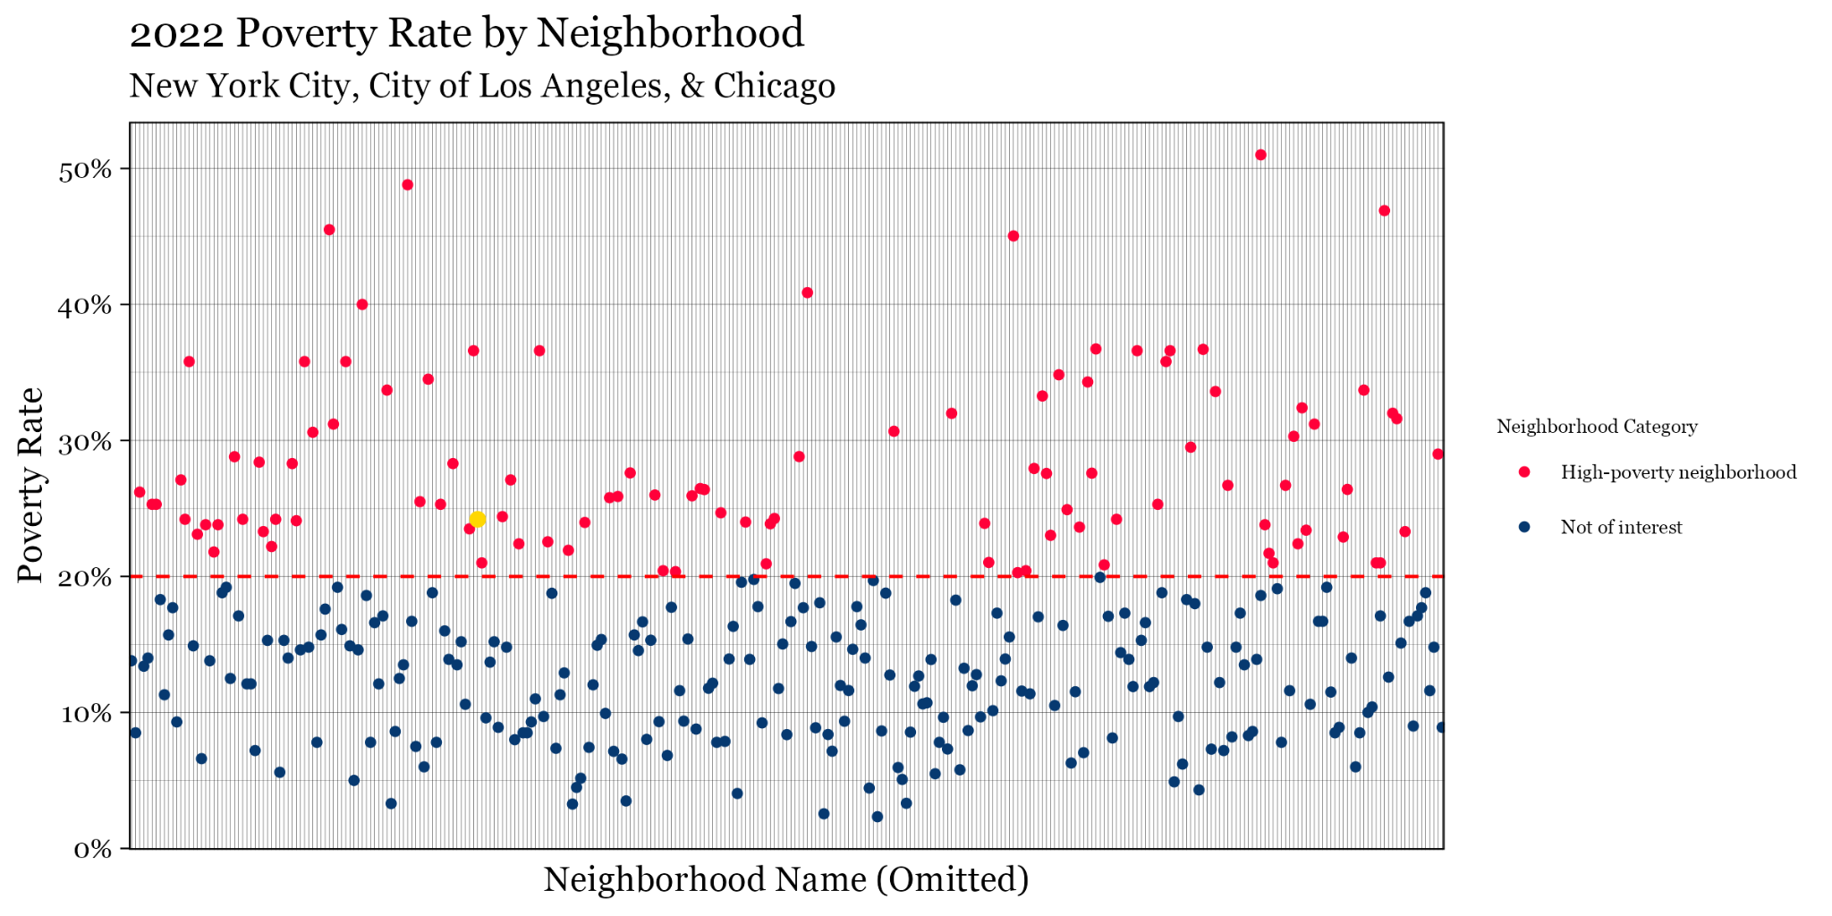
Eventually!
Goal
Question
Relevance
Data
Hyde Park, Chicago

Slide 9
Goal
Question
Relevance
Data
City Level
Inter-City Level
Chicago
1281 listed properties in 26 neighborhoods
41 neighborhoods
in 3 cities
New York City
519 listed properties in 8 neighborhoods
City of Los Angeles
317 listed properties in 7 neighborhoods

Slide 10
Goal
Question
Relevance
Data
Method: OLS regression models
City Level
Model 1
Chicago
Im(formula = PRICE ~ SQFT + house.age + PROP_TYPE + PARK_DIST + HOSPITAL_D + RAIL_DIST + BUS_COUNTS + FnB_COUNTS, data = chi_final_for_regression)
Model 2
NYC
Im(~, data = nyc_final_for_regression)
Model 3
LA
Im(~, data = la_final_for_regression)
Inter-City Level
Model 4
All
(Aggregated)
Im(formula = average_PRICE ~ SQFT + house.age + PROP_TYPE + PARK_DIST +HOSPITAL_D + RAIL_DIST + BUS_COUNTS + FnB_COUNTS + population.density +median .age + dominant.race，data = neighborhood_level_regression)
Notes:
Progress report: https://docs.google.com/document/d/1Tt_P23taxOHHhLULynLKjFe10fqJyPRJMJ-PClY1ynQ/edit

Slide 11
Inter-City Level
Notes:
~2-minute of Q&A

Slide 12
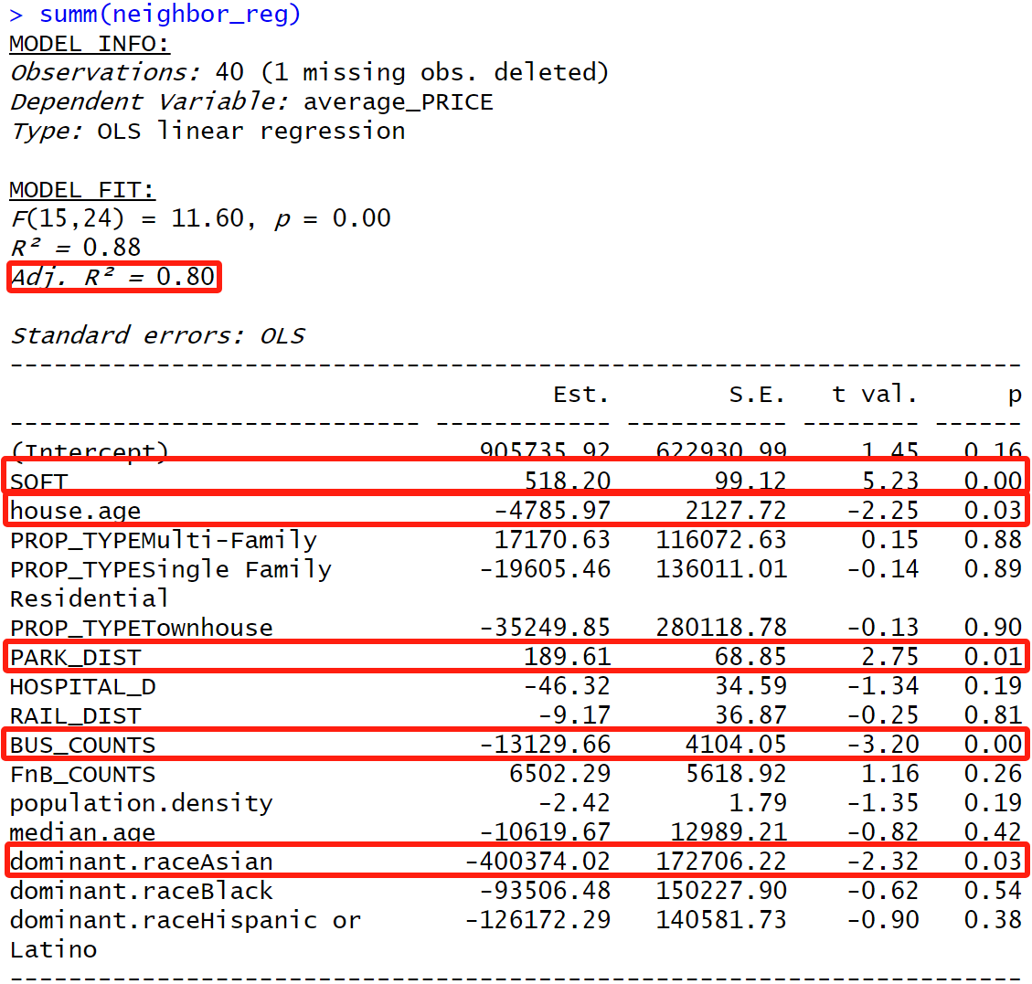
Goal
Question
Relevance
Data
Results
Inter-City Level
We got R-squared = 80%!!!
5 Findings at the Inter-City Level:
Square Footage
House Age
Park Distance
Bus Stops Count
Dominant Race (Asian)
Notes:
data analysis and visualization:
for example, if you are modeling data, present some selected descriptive stats, the model(s), and some selected results; if you are building an interface, demonstrate how to use it, etc.
choose clarity and simplicity over too many details: your classmates do not know much about your project and your goal is to make sure they understand what you have done in a few minutes
the presentation must include visualizations (as a guide, these should be between 3 and 6)

Slide 13
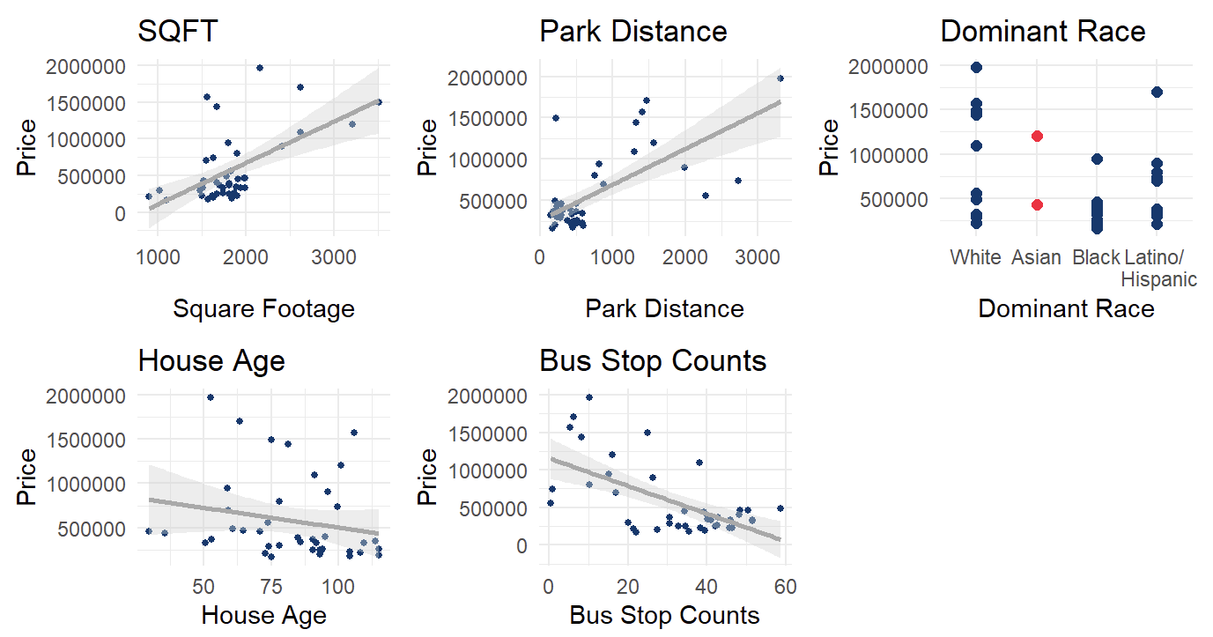
Goal
Question
Relevance
Data
Results
Inter-City Level
Notes:
data analysis and visualization:
for example, if you are modeling data, present some selected descriptive stats, the model(s), and some selected results; if you are building an interface, demonstrate how to use it, etc.
choose clarity and simplicity over too many details: your classmates do not know much about your project and your goal is to make sure they understand what you have done in a few minutes
the presentation must include visualizations (as a guide, these should be between 3 and 6)

Slide 14
City Level
Notes:
~2-minute of Q&A

Slide 15

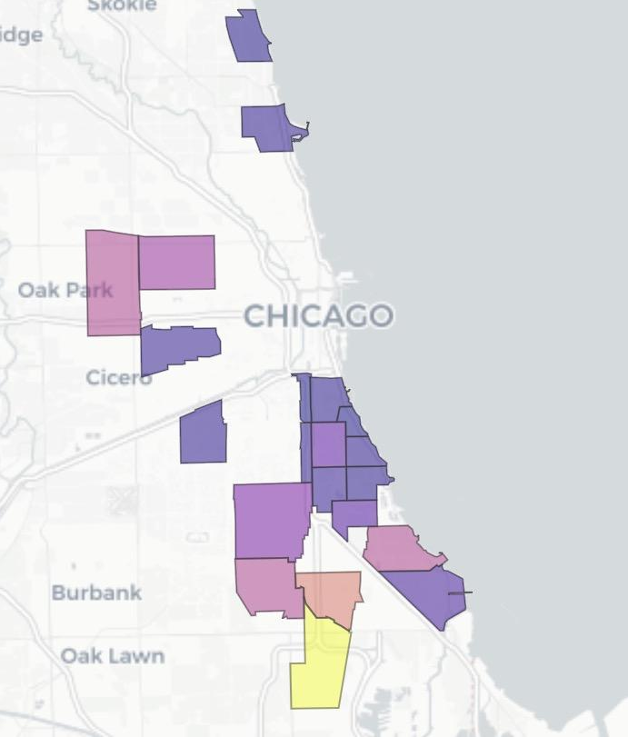
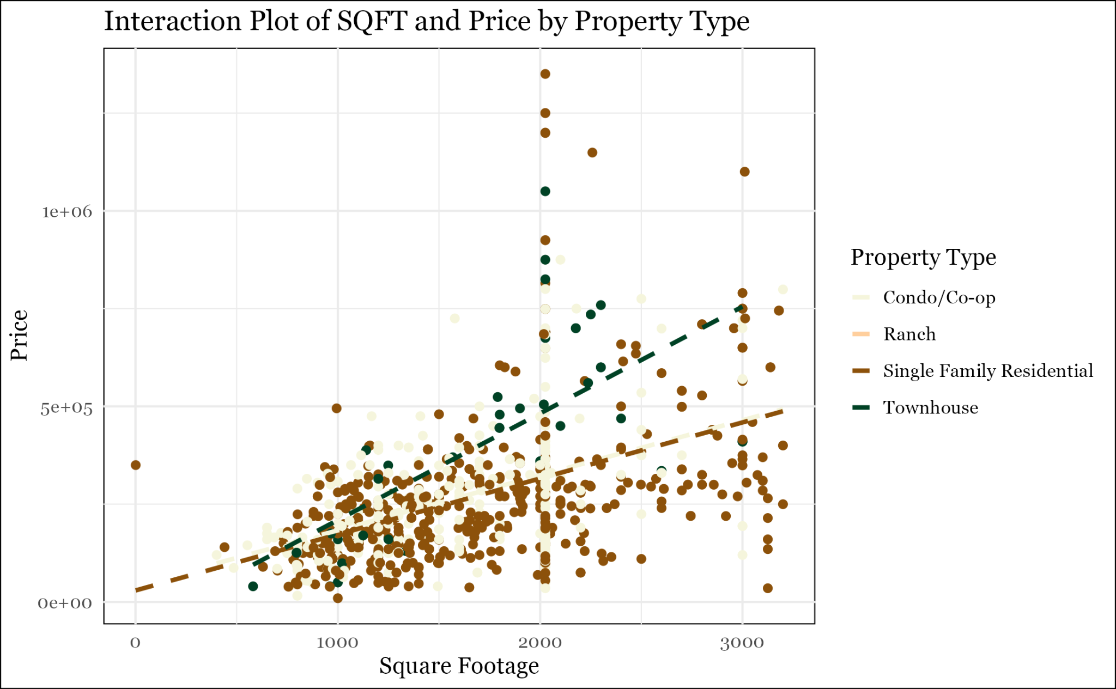
Chicago: Housing Type(HT) - Single Family Residential
Goal
Question
Relevance
Data
Results
Low High
Chicago
Number of Single Family Residential
Rogers
Park
Uptown
Humboldt
Park
Austin
North Lawndale
Armour Square
Douglas
Oakland
Brighton Park
Grand Blvd.
Kenwood
Fuller Park
Washington Park
Hyde Park
Englewood
Woodlawn
South Shore
Model | variable | coefficient | sd | p-value
Model 1 | HT-Single Family Residential | 144611.995 | 14721.228 | < 2e-16 ***
Auburn Gresham
Chatham
Roseland
South Chicago
Notes:
data analysis and visualization:
for example, if you are modeling data, present some selected descriptive stats, the model(s), and some selected results; if you are building an interface, demonstrate how to use it, etc.
choose clarity and simplicity over too many details: your classmates do not know much about your project and your goal is to make sure they understand what you have done in a few minutes
the presentation must include visualizations (as a guide, these should be between 3 and 6)

Slide 16
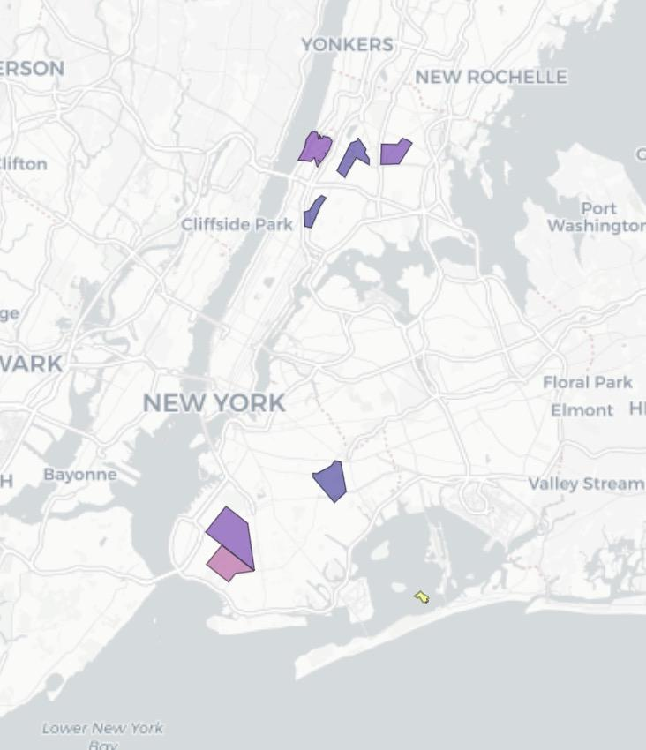
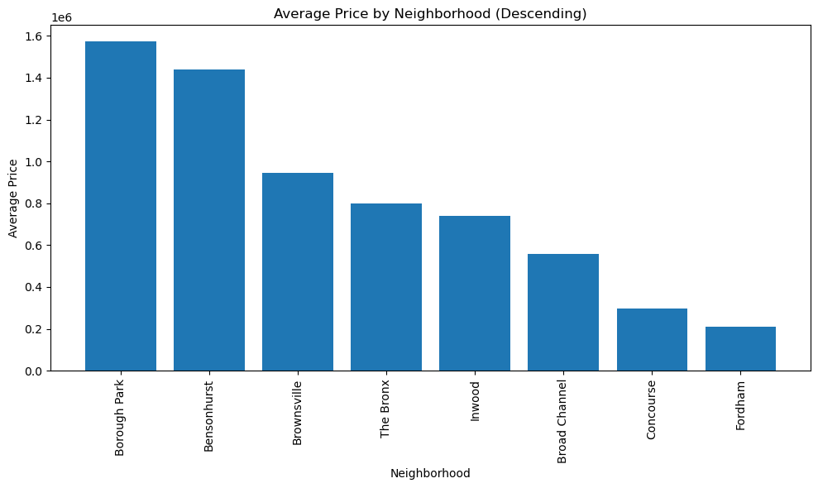
NYC: Hospital Distance
Goal
Question
Relevance
Data
Results
Low High
New York City
Hospital Distance
Fordham
Inwood
The Bronx
Concourse
Bensonhurst
Inwood
Concourse
Brownsville
Borough Park
Model | variable | coefficient | sd | p-value
Model 2 | Hospital Distance | 26.656 | 11.972 | 0.026415 *
Bensonhurst
Broad Channel
Notes:
data analysis and visualization:
for example, if you are modeling data, present some selected descriptive stats, the model(s), and some selected results; if you are building an interface, demonstrate how to use it, etc.
choose clarity and simplicity over too many details: your classmates do not know much about your project and your goal is to make sure they understand what you have done in a few minutes
the presentation must include visualizations (as a guide, these should be between 3 and 6)

Slide 17
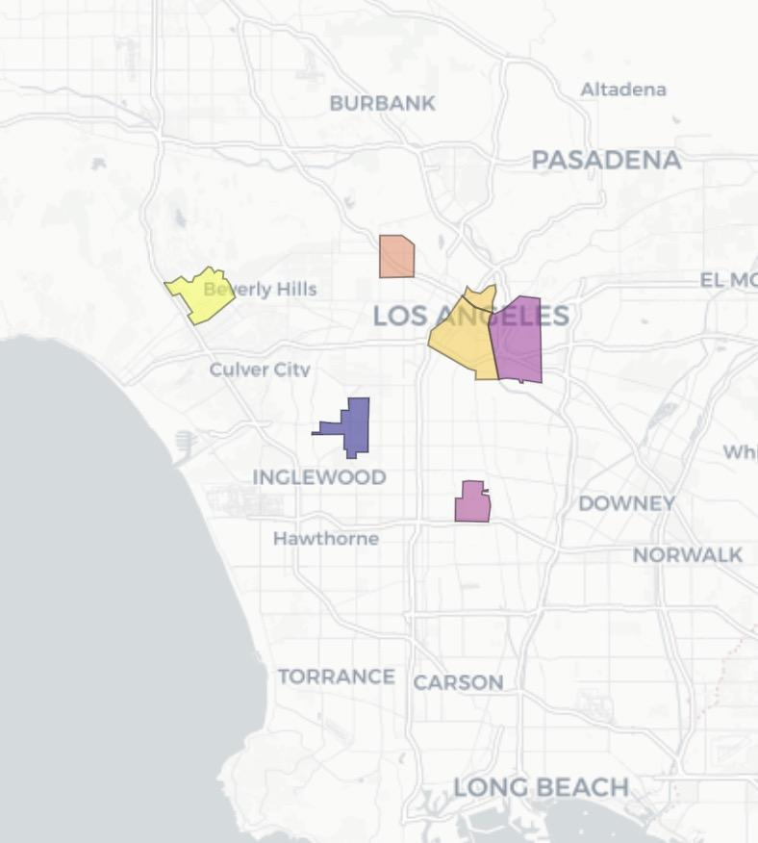
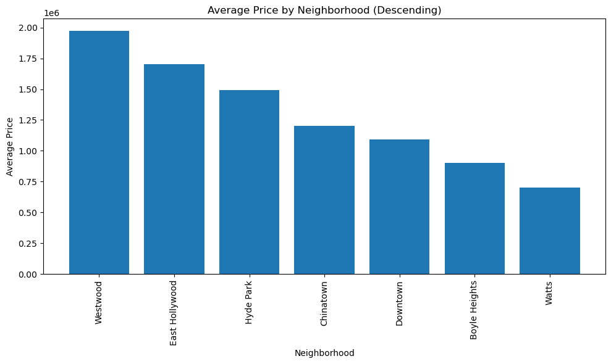
Los Angeles: Commercial Ambiance (Food & Beverage)
Goal
Question
Relevance
Data
Results
Low High
Los Angeles
Commercial Ambiance
East Hollywood
Chinatown
Westwood
Boyle Heights
DTLA
Hyde Park
Westwood
Chinatown
Watts
Watts
Model | variable | coefficient | sd | p-value
Model 3 | Food & Beverage Count | 20880.05 | 7094.28 | 0.003497 **
Notes:
data analysis and visualization:
for example, if you are modeling data, present some selected descriptive stats, the model(s), and some selected results; if you are building an interface, demonstrate how to use it, etc.
choose clarity and simplicity over too many details: your classmates do not know much about your project and your goal is to make sure they understand what you have done in a few minutes
the presentation must include visualizations (as a guide, these should be between 3 and 6)

Slide 18
Goal
Question
Relevance
Data
Results
Take-away
Conclusion
Neighborhood attributes weigh more than housing attributes as housing prices drivers in U.S. high-poverty neighborhoods.
Specifically, in these neighborhoods, within our expectations:
Larger houses still command higher prices.
Young houses are still more popular than the old.
Asians still tend to find good deals with lower housing prices.
Unexpectedly:
Being closer to parks could mean higher exposure to risky events.
People do not show more preference towards public transit (e.g. bus).
Other interesting findings:
Chicago values single-family residential way more than NYC and LA.
LA values business atmosphere more than Chicago and NYC.
NYC places less emphasis on the convenience of getting to the hospital than Chicago and LA.
Notes:
from the experience: what you learned while working on this project, suggestions, etc.
substantial: answers to your research question and future directions (work that could be done to improve your project)

Slide 19

Lessons we learned with blood and tear
Start early - Unexpected obstacles are everywhere.
No compatible version of selenium - Dynamic scraping
Terms of use causing ethical concerns of web scraping
Inconsistent naming of neighborhoods - Key-matching across tables
Think twice on the research scope.
We underestimated the complexity of merging datasets from different sources.
Find balance between a solid research design and the given timeframe to execute it.
Do more context-based research on data of interest before diving in.
Get familiar with a field’s research paradigm (in our case, the commonly used observation unit) before deciding on the unit for unfamiliar variables.
Goal
Question
Relevance
Data
Results
Take-away
Limitations
U.S. centric - We limit the generalizability scope within the U.S. high-poverty neighborhood, meaning that we could have had very different findings if analyze similar data from Tokyo or Hong Kong, where the ratio of property land to population is much higher.
Potentially biased inter-city level results due to the loss of data during the cleaning & merging process.
Notes:
from the experience: what you learned while working on this project, suggestions, etc.
substantial: answers to your research question and future directions (work that could be done to improve your project)

Slide 20
Q & A
Notes:
~2-minute of Q&A

Slide 21
Thank you!
Notes:
~2-minute of Q&A

